Slide 1

Welcome
By=Group 4

Slide 2

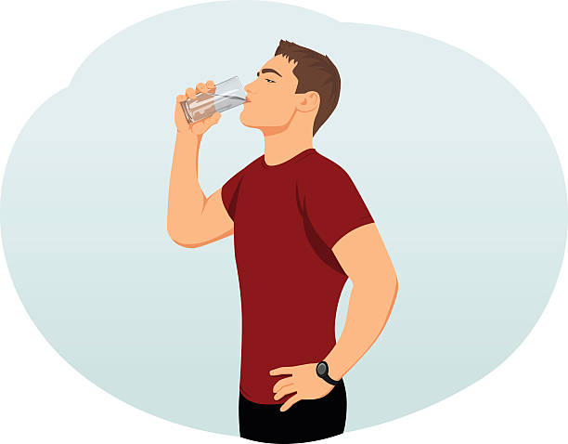


Environment is basically our surrounding. It’s the air that we breath, water that we drink, soil which we grow crops on etc.

Slide 3
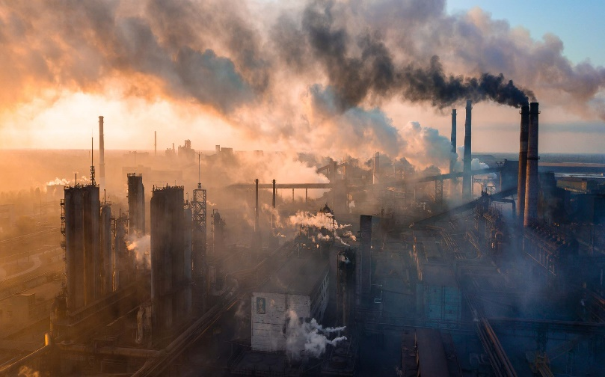
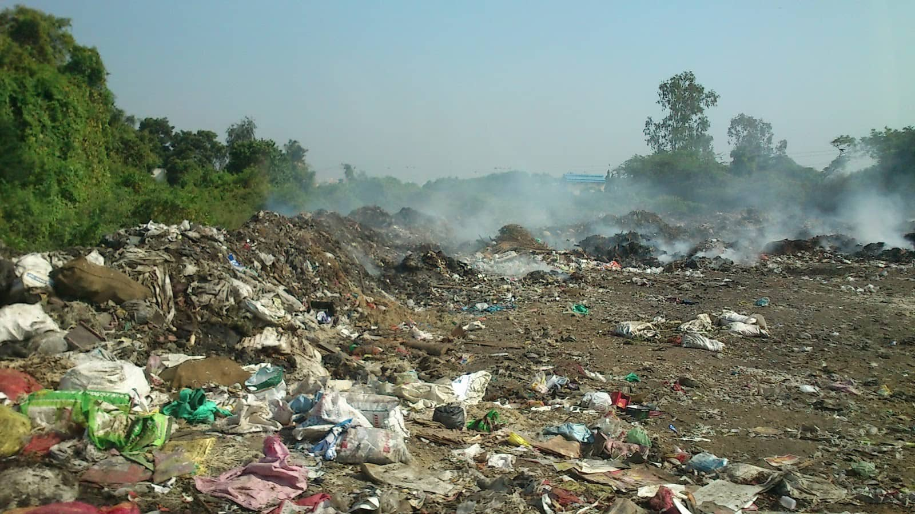

Now days its all getting polluted and problems like global warming, lung cancer, stroke etc.

Slide 4

So Engage with Nepal brought Eco-club which helps us to clean the environment, \Make it a better place to live in. And teach the students the importation of environment, how should we keep it clean and other good habits. Right now eco-club has been spread all over the schools of Nepal.

Slide 5
In order to bring all those eco-communities closer we have brought a web page which connects unites all the member schools of eco-communities together.

Slide 6
Home page
We have also created a homepage in order to briefly introduce you to our other homepage will also hold the contact info of engage Nepal with science and a donate button so that others can help out engage Nepal with science whenever they want to.

Slide 7
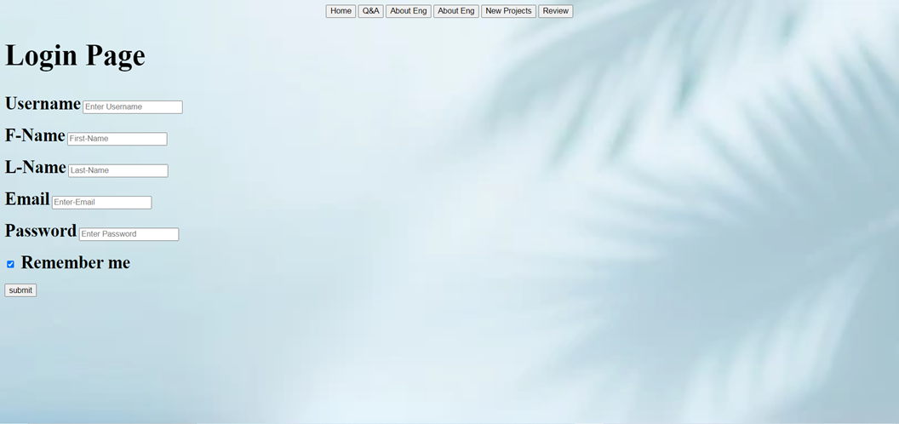
Login Pages
In our web-page we have a login page. It’s your choice weather you want to login right way or after taking your time.

Slide 8


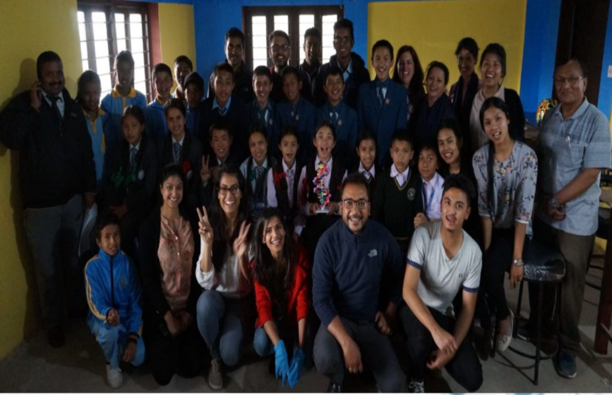
Engage Nepal With Science
After home page we decide to give our users a brief introduction about ENWS. The page holds the info like the name of the person who started it Alba Albad, it was started at 2010 AD.

Slide 9



Eco-Club
WE also have a page dedicated to eco-club. It contains the information about meaning of eco-club, its aim when did it get started, the school members of eco-club, the activities of eco-club etc.

Slide 10
Projects
Our another page had the hold of all the new projects which are going to be launched by eco-club, And people can also suggest new projects in the particular page while you can also fill up a particular form in-order to take part in the website.

Slide 11
Q&A
How comes the interactive page where anyone can ask about their queries related to eco-club or ENWS and anyone can reply to the answer, or anything containing in the website.

Slide 12
Review and Feedback
At the end you can rate our website and write about your thoughts on our website. Any compliments or suggestions would be appreciated.

Slide 13

Any Questions

Slide 14


